Slide 1

Health Apartment Working Group
Kickoff Meeting
OCTO and OCC | October 27, 2021
Notes:
Meg

Slide 2

Agenda
INTRODUCTION
Introduction (7 min)
Where we are (20 min)
Collaboration (5 min)
Feedback (20 min)
Closing (3 min)
Health Apartment Working Group | October 27, 2021

Slide 3
Objectives
INTRODUCTION
Introduce the Health Apartment Team
Share where we are and what’s ahead
Learn where the health apartment intersects with your work
Discuss how to collaborate with you
Health Apartment Working Group | October 27, 2021

Slide 4








Health Apartment Team
INTRODUCTION
OCTO Leadership Team
Charles Worthington (CTO) Chris Johnston (Product Line Manager) Jeff Barnes (Dep. Product Line Manager) Lauren Alexanderson (Dep. CTO, Health Delivery)
Core Team
Shawn Drinkard Program Manager,
MO Studio
Lauren Alexanderson Program Manager, OCTO
OCC Leadership Team
Kathy Frisbee (Acting Head, Office of Connected Care) Nancy Wilck (Director, Digital Health) Theresa Hancock (Director, My HealtheVet)
Lara Siopis Interim Product Manager, UX Lead, MO Studio
Meg Peters Product Owner, OCTO
Jeff Scheire Interim Product Manager, MO Studio
Jared Cooke Front-End Engineer, MO Studio
Extended Team Partners
OCC / My HealtheVet teams OCTO teams working on health-related and sitewide things
Paula Mendoza
UX Designer, Scrum Master, MO Studio
Nadya Primak Front-End Engineer, MO Studio
Health Apartment Working Group | October 27, 2021

Slide 5
Where we are

Slide 6
Vision
WHERE WE ARE
To simplify and unify the Veteran digital health experience by creating an accessible, usable, and discoverable health “apartment” on VA.gov.
This will give Veterans a single place to accomplish all of their key health tasks.
To learn how we got here, read this onboarding guide.
Health Apartment Working Group | October 27, 2021

Slide 7
Here’s what we’re up to
WHERE WE ARE
Research on the information architecture (IA) of the health apartment
Technical discovery on MHV and VA.gov systems and architecture
Talking to teams in OCTO and OCC about: 1) how the health apartment concept intersects with their work + how to collaborate, and 2) what we need to know to build a proof of concept
Building the Health Apartment Team
Health Apartment Working Group | October 27, 2021

Slide 8
Research on the IA of the health apartment
WHERE WE ARE
We have a proposed structure for the health apartment.
We’re testing it to find out:
Is the information organized in a way that makes sense to Veterans?
Does what we’re calling things resonate with them?
The tree test will also give us a clear, quantifiable baseline that will help us iterate on the design of the health apartment.
View the research plan and preview the tree test.
Health Apartment Working Group | October 27, 2021

Slide 9
Discovery
WHERE WE ARE
Soon we will talk with:
TBD date: Theresa Hancock (MHV)
TBD date: Barry Egbert (MHV)
TBD date: VA.gov flagship mobile app team
And we’re attending working groups:
Identity Working Group
MHV-OCTO appointments gap analysis team sync (soon)
Thank you all for your time!
We’ve talked with:
Barry Egbert, MHV Application Architect
Mike Chelen, VA.gov Technical Architect
David Conlon, Public Websites Crew Chief
Cory Trimm, VA.gov Engineering Practice Lead
Cody Reinold and John Rahaghi, Identity Team
Mikki Northuis, VA.gov Information Architect
Danielle Thierry, Content Lead
Kevin Hoffman, Account Experience Crew Chief
Samara Strauss, Account Experience Product Lead
Shira Goodman, Platform / Collaboration Cycle
Health Apartment Working Group | October 27, 2021

Slide 10
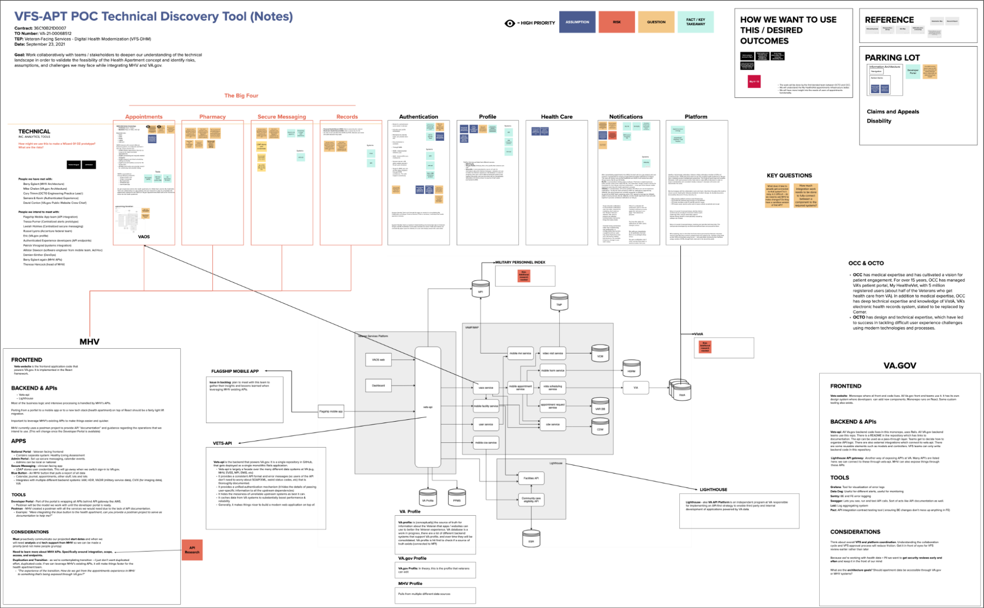
Technical discovery
WHERE WE ARE
We’re synthesizing and documenting our findings in a way that shows risks, assumptions, and challenges.
This will help as we design and build the proof of concept. And we hope other teams can benefit from our findings.
View the Technical Discovery Summary.
View the Technical Discovery Synthesis in Mural.
Health Apartment Working Group | October 27, 2021

Slide 11
In our conversations, we’ve heard…
WHERE WE ARE
“This Mural is great. I would like a copy of this when it’s done. It would be a helpful tool in onboarding new team members.” – Engineering Lead (about the technical discovery Mural)
“I’m not attached to current dashboard. I’m willing to solution together to ultimately serve Veterans.” – Authenticated Experience
“Everyone is in discovery mode. Not everyone has whole picture.” – Identity
Health Apartment Working Group | October 27, 2021

Slide 12
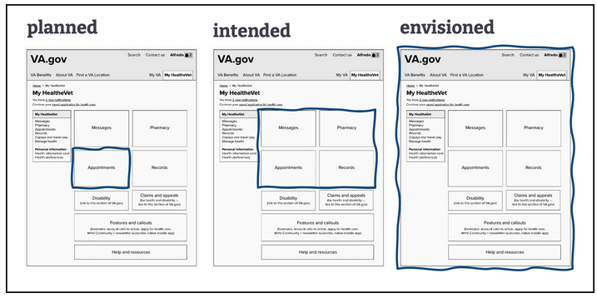
Proof of concept (POC)
WHERE WE ARE
By testing a PoC before building an MVP, we will validate or invalidate the health apartment concept with Veterans. How well does it meet their needs? How can we improve it?
Our goal for ‘planned’ work is to ship the proof of concept by December 2021.
DRAFT
Health Apartment Working Group | October 27, 2021

Slide 13
Building a proof of concept also lets us…
WHERE WE ARE
Get real Veteran feedback on how the health apartment is organized.
Test how easy it is to find the health apartment on VA.gov.
Coordinate with VA.gov and MHV teams on how to integrate the health apartment into VA.gov.
Health Apartment Working Group | October 27, 2021

Slide 14
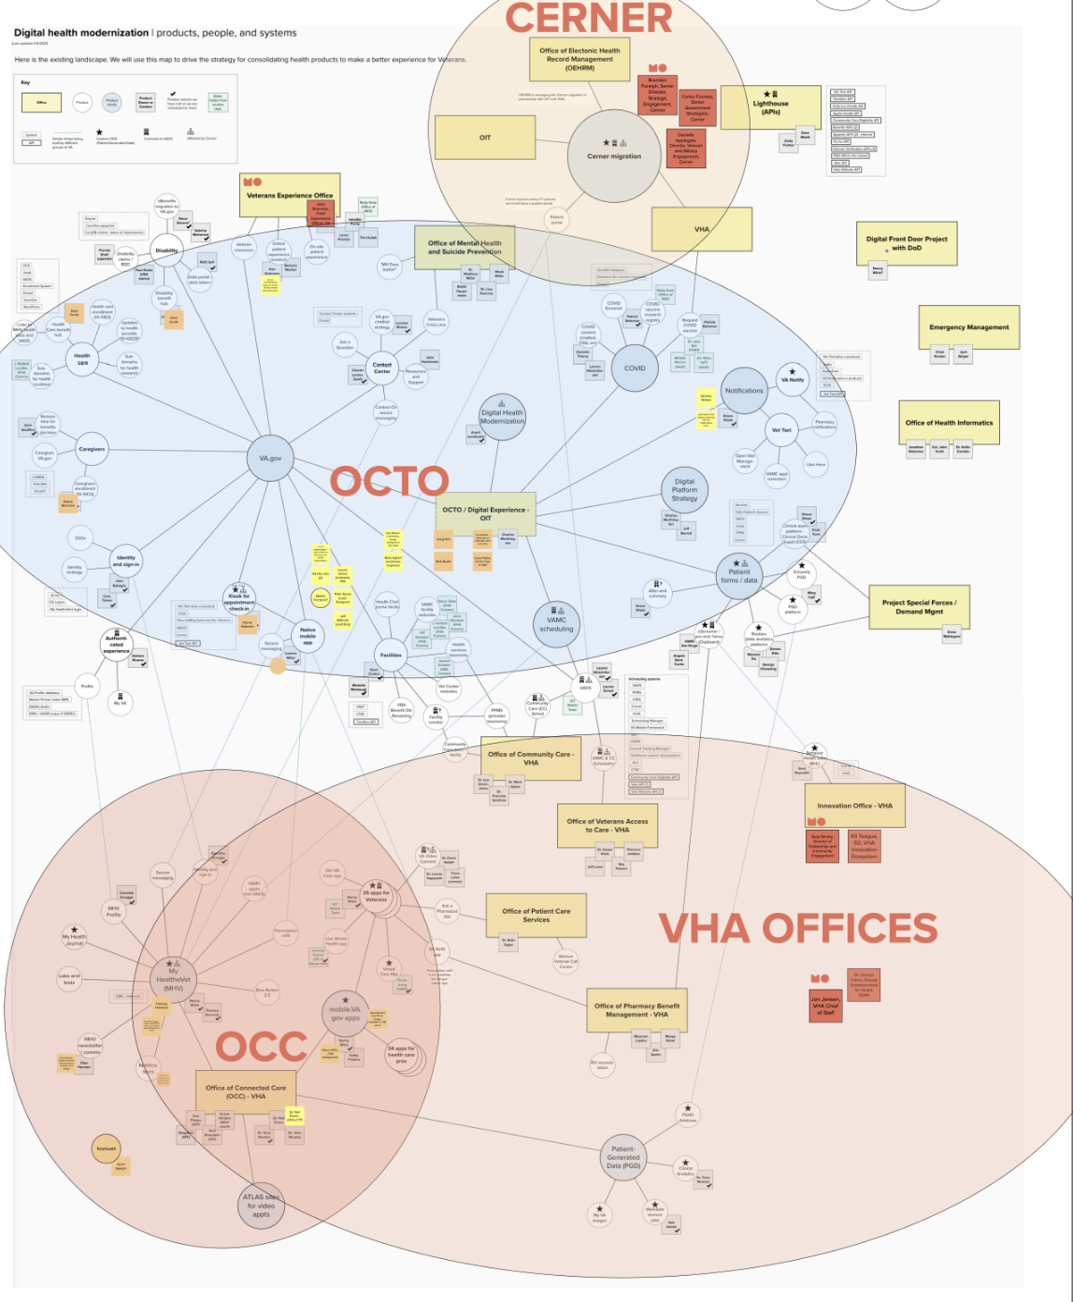
Building the team
WHERE WE ARE
We’re designing our team to fit the complexity of the landscape. We’re thinking about our team not only from a staffing / hiring perspective, but also with respect to collaboration across teams.
Health Apartment Working Group | October 27, 2021

Slide 15
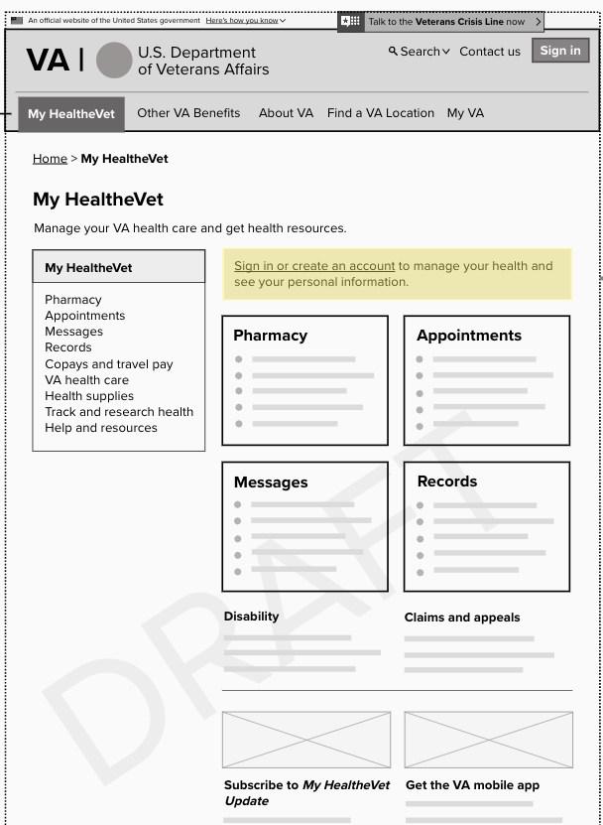
Roadmap
WHERE WE ARE
Today
PHASE
Planned work
Intended work
SPRINT
0
1
2
3
4
5
6
7
8
9
10
11
MONTH
September
October
November
December
January
February
EPIC
Onboard Landing Team and Kickoff Project
Proof of concept
Recruiting, Hiring, and Onboarding
Deep Dive into Research, Discovery and POC
Workshops and MVP Down Selection
Problem Definition, Approach, and Sprint Planning
Proof of Concept Design, Build, and Test
Health Apartment Working Group | October 27, 2021

Slide 16
Related work
WHERE WE ARE
The separate work stream on appointments analysis started last summer.
This work is blazing a trail for the health apartment in several important ways:
The analysis is being done by the first blended team between OCTO and OCC.
We’ll understand the My HealtheVet appointments infrastructure better.
We’ll have more insight into user needs related to appointments.
Health Apartment Working Group | October 27, 2021

Slide 17
Collaboration

Slide 18
We’ll collaborate with you on these things and more.
COLLABORATION
Appointments
Sign-in
Authenticated experience (notifications, My VA, VA.gov Profile, MHV Profile, and user flows)
VA.gov flagship mobile app
Medical finances
Navigation
Content
Health Apartment Working Group | October 27, 2021

Slide 19
We look forward to working with you!
COLLABORATION
Collaborating with you and with others, across teams
Sharing and learning in this monthly working group
Finding where the health apartment work overlaps with yours and working through dependencies and challenges
Hearing your concerns and making connections with other health partners
We’re excited to kick off this working group!
Health Apartment Working Group | October 27, 2021

Slide 20
Feedback

Slide 21
Look for a quick post-session poll.
FEEDBACK
We want to hear from you! Through the poll or by email, send us your:
Questions
Thoughts on changes to this meeting format
Feedback on the timing of this meeting + suggestions for alternate times
Ways to bring people into the discussion at relevant touch points
Any other feedback
Health Apartment Working Group | October 27, 2021

Slide 22
Thank you!
Have questions? Want to discuss something?
Reach out to meg.peters@va.gov.

Slide 23
Appendix

Slide 24
Mission
APPENDIX
The Health Apartment Team’s mission is to simplify Veterans’ health experience on the web, picking up where the DHM Team left off. The original DHM Team has fulfilled its mission and our goal is to build on the great work of MHV. Going forward, work on the health apartment will be one of many digital health modernization efforts.
To get the health care they need, Veterans must find, register for, and learn to use a number of different websites and software products. Our generative research from late 2020 shows that Veterans find it extremely difficult to navigate commonplace interactions with VA health care. The VA ecosystem is so complex that Veterans feel discouraged to apply for, manage, and maximize their benefits.
Consider booking a doctor’s appointment: One system locates nearby facilities. Another schedules appointments. Another handles follow-ups like messages and prescriptions. And another reimburses travel expenses. That’s a lot for Veterans to learn. It’s also difficult for VA staff to support so many siloed systems.
We aim to reduce the number of websites, products, and interfaces (i.e., friction points) Veterans must use in order to get health care and manage their health — and we aim to make those experiences easy and intuitive.
Health Apartment Working Group | October 27, 2021

Slide 25
Acronyms
APPENDIX
DHM – Digital Health Modernization (team in OCTO that paved the way for the health apartment work)
MHV – My HealtheVet
OCTO – Office of the Chief Technology Officer
POC – proof of concept
VFS – Veteran-Facing Services
Health Apartment Working Group | October 27, 2021

